Slide 1
Adaptive Cards
Handling actions

Slide 2

Handling actions
Service requirements and registration
Action status and Card refresh
Security Considerations

Slide 3

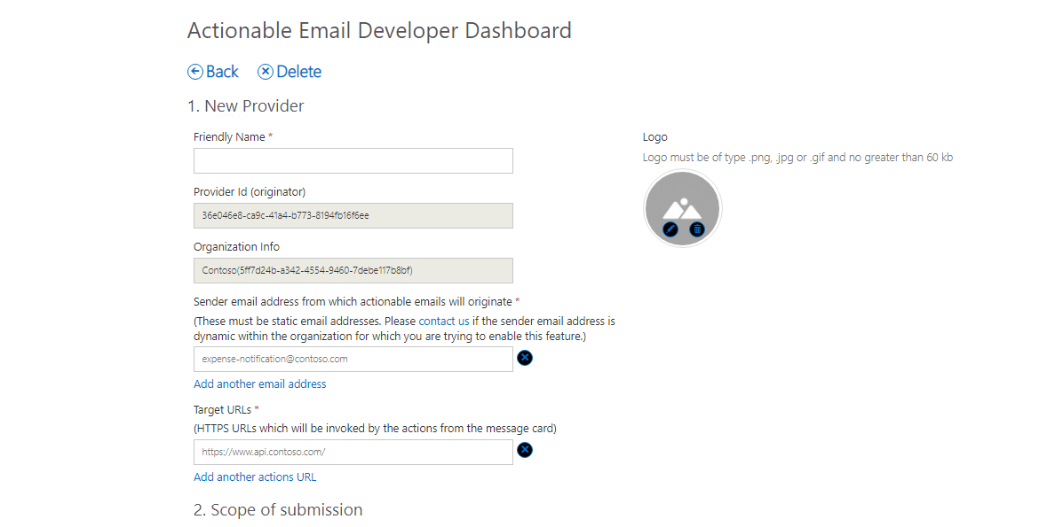
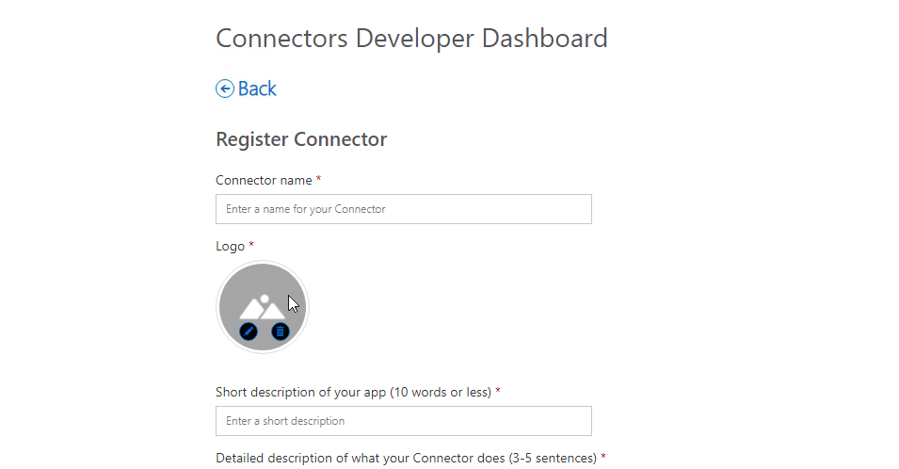
Actionable Email Developer Dashboard
https://aka.ms/publishoam
Notes:
Your Action URLs will not work until the URL is registered in the Actionable Email Developer Dashboard.
Developer flow:
Use the MessageCard Playground to view samples and design your own cards.
Use the Actionable Email Developer Dashboard to register providers (approved URLs)
Test your provider’s actions
Every unique scope (My Mailbox, Organization, or Global) must be registered individually.
Developers aren’t blocked on the approval, they can send actionable messages to themselves – cards would render and actions would work without requiring an approval. The approval is required only to be able to send actionable messages to others.

Slide 4

Registration criteria for global submission scope
Emails must be authenticated via DKIM or SPF
Top-level domain (TLD) of the SPF check or DKIM signature must match the TLD of your From: email address
Emails must come from a static email address
Emails must follow the email sender guidelines
Consistent history of sending a high volume of mail from your domain
Very low rate of spam complaints from users
Use high-fidelity, routine and simple actions available for your service, otherwise use OpenUri actions for complex interactions
Actions should be used for transactional email where a high interaction rate is expected, they should not be used for promotional bulk mail
https://docs.microsoft.com/en-us/outlook/actionable-messages/email-dev-dashboard
Notes:
This section is only applicable when your scope of submission to enable actionable messages is Global.
In this section, you need to provide details for Microsoft to verify the actionable message and the corresponding actions that are invoked from the email sent by your provider/service.
Additionally, send a valid email coming from your production servers (or a server with similar DKIM/SPF/From:/Return-Path: headers) including the markup to amverify@microsoft.com. This procedure will enable Microsoft to determine that the solution complies with all the guidelines and requirements listed in Registration Criteria.
Make sure that the markup is correct prior to sending the email.
Office 365 removes all markup when forwarding an email. Do not forward the email but send it directly.

Slide 5

Action processing overview
Office 365
Receive email with card
1
3
HTTP POST + bearer token
2
Submit
Status + refresh card
4
Outlook
Web app
Notes:
Action processing requires a publicly reachable endpoint that is pre-registered using the Actionable Email Developer Dashboard. You cannot use http://localhost as a URL because that is unreachable from Office 365.
User receives an email with an actionable message embedded in the <script> tag
User interacts with the message action defined in the card such as HttpPOST
The HTTP POST message is sent from Office 365 to the pre-registered endpoint. The HTTP POST includes a bearer token that should be validated.
The status is returned in the HTTP header CARD-ACTION-STATUS with a value indicating success or failure. Optionally, the response body can contain JSON to represent the new UI of the card after successful processing. This requires the CARD-UPDATE-IN-BODY HTTP header with a value of “true”

Slide 6
Actionable messages via email
Card-enabled mail client
Email Server
https://api.contoso.com
Office 365
Send email w/ card
Retrieve email w/ card
Invoke Http action
httpPOST + bearer token
Status + refresh card
Card response
Notes:
The process begins by your web application sending an Actionable Message to your email server. This can be Office 365 or can be another email server that meets requirements (see https://docs.microsoft.com/en-us/outlook/actionable-messages/security-requirements).
A client capable of displaying message cards displays the email. Clients not capable of displaying message cards will only show the message body, so it’s important to include a meaningful message body.
The card-enabled client, such as Microsoft Outlook, enables the user to click on an action such as “Approve Expense Report”. This causes a message to be sent to Office 365.
Office 365 then sends an HTTP POST request to your application, adding an HTTP header “Authorization: bearer “ plus a signed Oauth token (JWT formatted token).
Your application validates the token, then sends as the response an HTTP header indicating success or failure. Additionally, the body of the response can include JSON data representing the new UI for the card.
Finally, the full response is sent back to the mail-enabled client from Office 365.

Slide 7
Reporting success or failure
CARD-ACTION-STATUS
HTTP header indicating success or failure to the user
if (!result.Sender.ToLower().EndsWith(SenderEmailDomain))
{
var errorResponse = request.CreateErrorResponse(HttpStatusCode.Forbidden, new HttpError());
errorResponse.Headers.Add("CARD-ACTION-STATUS", "Invalid sender.");
return errorResponse;
}
// prepare the response
var response = Request.CreateResponse(HttpStatusCode.OK);
response.Headers.Add("CARD-ACTION-STATUS", "Comment recorded...");
return response;
Notes:
Use the CARD-ACTION-STATUS header to provide descriptive text if the operation succeeds or fails.
Do not include user information in the status.

Slide 8
Refresh cards
CARD-UPDATE-IN-BODY
HTTP header indicating success or failure to the user
Allows an HttpPOST action to fully update the card as the action successfully completes
Include the JSON payload of the new card in the body of the response
Add the CARD-UPDATE-IN-BODY: true header to the response
// create the card
AdaptiveCards.AdaptiveCard refreshCard = CreateRefreshCard(comments);
if (refreshCard != null)
{
// add the Action.Http block to the card.
refreshCard.Actions.Add(CreateHttpAction(comments));
response.Headers.Add("CARD-UPDATE-IN-BODY", "true");
response.Content = new StringContent(refreshCard.ToJson());
}
Notes:
After the user completes an action, the card body can be refreshed to include details of the interaction such as an expense approval number or a support ticket number.

Slide 9
Validating the bearer token
Validation library:
NuGet Package: Microsoft.O365.ActionableMessages.Utilities
Validation class: Microsoft.O365.ActionableMessages.Utilities.ActionableMessageTokenValidator
Source: https://github.com/OfficeDev/o365-actionable-messages-utilities-for-dotnet
Verifies the following:
The token is issued by Microsoft and its digital signature is valid.
The token has not expired.
The audience claim matches the service domain URL.
var validator = new ActionableMessageTokenValidator();
var result = await
validator.ValidateTokenAsync(
Request.Headers.Authorization.Parameter,
"https://api.contoso.com");
Notes:
Office 365 will call your configured URL, passing an Authentication header with a value of “bearer” plus a signed, encoded token. Your web API can inspect the bearer token and use the Microsoft.O365.ActionableMessages.Utilities NuGet package
ValidateTokenAsync will verify the following
1. The token is issued by Microsoft and its digital signature is valid.
2. The token has not expired.
3. The audience claim matches the service domain URL.
The source code for the library is available at:
https://github.com/OfficeDev/o365-actionable-messages-utilities-for-dotnet

Slide 10
Validating the bearer token
public async Task<HttpResponseMessage> Post([FromBody]string value)
{
//Validate token
var validator = new ActionableMessageTokenValidator();
var result = await validator.ValidateTokenAsync(Request.Headers.Authorization.Parameter, "https://api.contoso.com");
if (!result.ValidationSucceeded) {
return CreateCardResponse(HttpStatusCode.Unauthorized, "Invalid token");
}
//Custom business logic to validate the sender and/or performer
if ((!result.Sender.ToLower().EndsWith("@contoso.com") || !result.ActionPerformer.ToLower().EndsWith("@contoso.com")) {
return CreateCardResponse(HttpStatusCode.Forbidden, "Invalid sender or the performer is not allowed.");
}
// TODO: Add business logic code here to process the expense report.
return CreateCardResponse(HttpStatusCode.OK, "The expense was approved.");
}
Notes:
Office 365 will call your configured URL, passing an Authentication header with a value of “bearer” plus a signed, encoded token. Your web API can inspect the bearer token and use the Microsoft.O365.ActionableMessages.Utilities NuGet package
ValidateTokenAsync will verify the following
1. The token is issued by Microsoft and its digital signature is valid.
2. The token has not expired.
3. The audience claim matches the service domain URL.

Slide 11
Demo

Slide 12

Summary
Actions can be added to actionable messages
Action.Http action allows processing of HTTP POST requests
Web APIs that process POST requests must validate the bearer token
Return the CARD-ACTION-STATUS HTTP header to indicate meaningful status
Return the CARD-UPDATE-IN-BODY HTTP header to refresh card with JSON in body of response

Slide 13
Thank you

